Slide 1
Workshop 1 Afternoon session
Data Information and structures

Slide 2
Introduction to Data Structures
Basic data Structures
Intermediate Data Structures
Advanced Data Structures
Structured Data
Unstructured Data
Management of data
Notes:
Data Structures are widely used in almost every aspect of Computer Science i.e. Operating System, Compiler Design, Artificial intelligence, Graphics and many more.
So lets start…………….. Next slide

Slide 3
Basic Terminology
Recap Question: What is Data?
Group Items: Data items which have subordinate data items are called Group item, for example, name of a student can have first name and the last name.
Record: Record can be defined as the collection of various data items, for example, if we talk about the student entity, then its name, address, course and marks can be grouped together to form the record for the student.
File: A File is a collection of various records of one type of entity, for example, if there are 60 students in the class, then there will be 60 records in the related file where each record contains the data about each student.
Attribute and Entity: An entity represents the class of certain objects. it contains various attributes. Each attribute represents the particular property of that entity.
Field: Field is a single elementary unit of information representing the attribute of an entity.
Data can be defined as an elementary value or the collection of values, for example, student’s name and their id are the data about the student.
Notes:
When choosing the appropriate data structure for a program is the most difficult task for a programmer. These are some of the basic terminologies that you may come across .

Slide 4

Data Lakes
All data is loaded from source systems. No data is turned away.
Data is stored at the leaf level in an untransformed or nearly untransformed state. Hierarchy (Root -> Internal (Branch) -> Leaf)
Supports all data types and all users (customers to engineers)
Data in its natural state, not yet cleansed or packaged. Data flows from streams (the source systems) into the lake, from which analysts can examine, take samples or create a pipeline out for cleaning and packaging.
ETL pipeline
Data Sources
Data Sources

Slide 5
What are Data Structures ?
Basic Data Structures
Password Databases
Online Directories
Advanced Data Structures
Undo/Redo Function
Spell Check
Text searching
The key role of a computer program is to store and process data. Any computer software has a data model that defines what data will be collected and worked on. The data structure defines how the flow of data is controlled in relation to inputs, processes and outputs.

Slide 6
Qualitative and Quantitative Data
Qualitative data does not include numbers in its definition of traits .
Example:
The cake is orange, blue, and black in colour (qualitative).
Females have brown, black, blonde, and red hair (qualitative).
Quantitative data is all about numbers.
Example:
There are four cakes and three muffins kept in the basket (quantitative).
One glass of fizzy drink has 97.5 calories (quantitative).

Slide 7
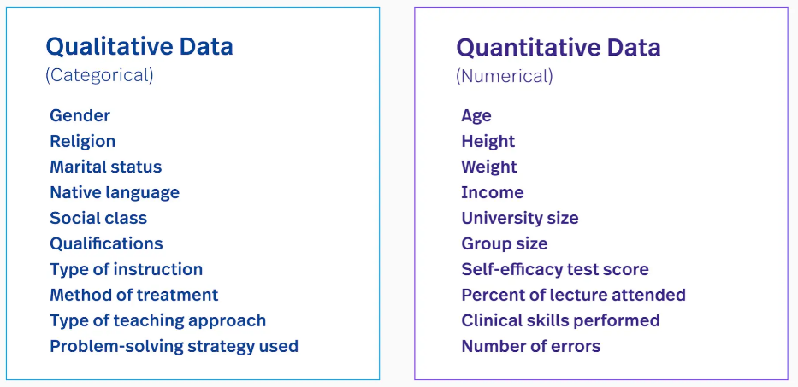
Qualitative and Quantitative Data
Notes:
Image source:https://www.fullstory.com/blog/qualitative-vs-quantitative-data/#:~:text=Quantitative%20data%20is%20numbers%2Dbased,what%20happened%20behind%20certain%20behaviors.

Slide 8
Management of data
Structured data
Unstructured data

Slide 9
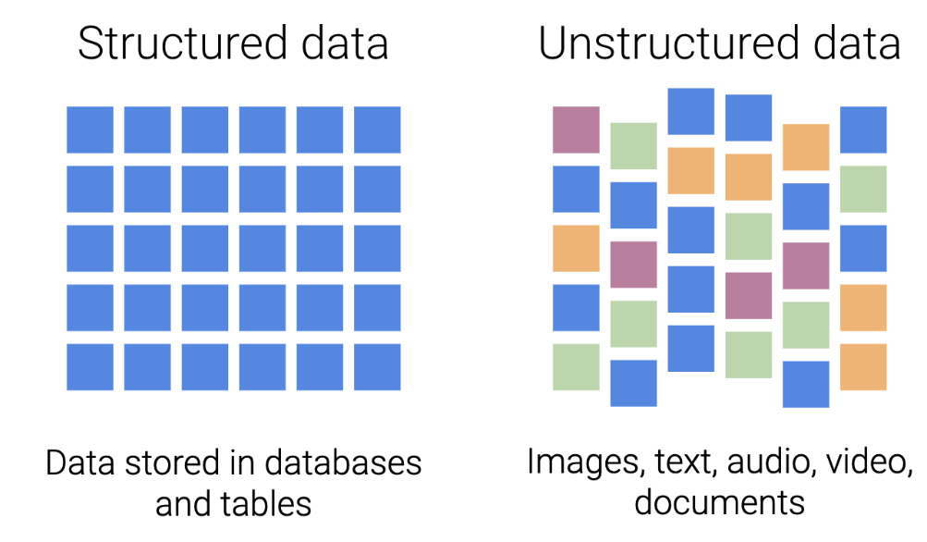
Management of data
When providing the set of attributes and matching structures that will be used to store records in a database management system, data structures are utilised to efficiently persevere data.
Structured data refers to data that is entered and maintained in fixed fields within a file or record. For example, when you submit your name, address, and billing information to a website, you are creating structured data
Unstructured data lacks the organisation found in structured data. It does not possess the scaffolding that identifies the value of the data. Unstructured data lacks a set way of entering or grouping the data, and then analysing the data.
Examples of unstructured data include the content of photos, audio and video files.
Notes:
Computers generally lack the appropriate awareness and perception of humans. So as a result it is important to consider the following two states of data: structured and unstructured data

Slide 10
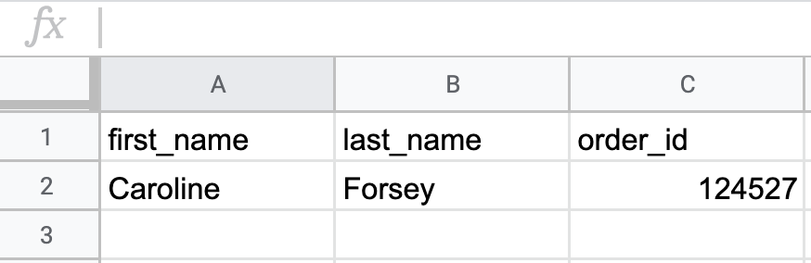
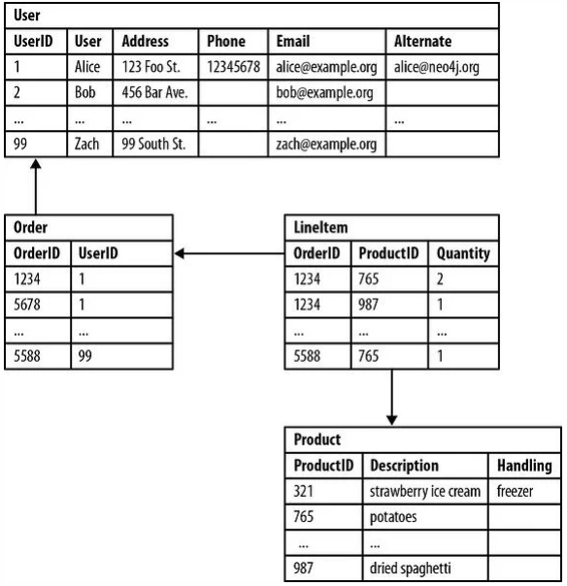
Structured Data
Structured data refers to:
Text, Numbers, Dates, currencies,
Unicode (so…emojis?)
Can be human or machine created,
examples include:
Airline reservations
Sales transactions
Customer information
And usually resides in Relational databases

Slide 11
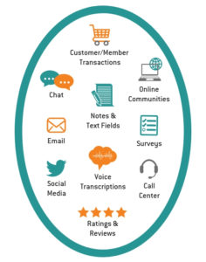
Unstructured Data
Text Files (entire text documents, ppt, pdfs)
Email (semi-structured as it contains metadata)
Media: Music, Videos, Pictures
Scientific data: Space exploration, seismic imagery, atmospheric data, geology
Surveillance: recognition patterns
Sensor data (traffic, oceanographic)

Slide 12
Data
Raw (uncleaned)
Clean
Unstructured
Structured (Does not contain duplicates, missing values and outliers)
Structured (Contains duplicates, missing values and outliers)
Unstructered
Raw (uncleaned data)
Raw (uncleaned data)

Slide 13
Recap Questions
Can you give examples of structured and unstructured data ?

